Slide 1
LTI Assurance Services for Phoenix
29 Aug 2017

Slide 2
Agenda
1
Our Understanding
2
LTI’s Point of View of Quality Assurance
3
Phase 1- Bolster the Basics
What does the process look like in detail?
What would the organization look like?
How would the Tooling/Environment be managed?
4
Phase 2-Transformation and Continuous Improvement

Slide 3


LTI’s Point of View of Quality Assurance
20
Traditional Cost of Quality computations ( which is 15-20% of IT Apps spend) focuses mostly testing effort. LTI’s Holistic view of also includes hidden components such as :
Technical Debt: Loss of quality outcomes that can be attributed to sub-optimal coding practices & configuration mistakes over time
Test Ecosystem: Ability to have a performing environment on demand using cloud / hybrid infrastructure
Data & Compliance: Ability to provision sanitized data for testing and aligning to data security regulations. New regulations such as GDPR mandate that data security is build into the life cycle and not retrofitted by a separate compliance team
End User Experience: Include quality of End User Experience to significantly make an impact in the marketplace
Functional & Non Functional Testing
Test Management & Reporting
Visible
Testing Effort
15-20%
10
0
Maintainability, Robustness of code
Configuration best practices
Technical Debt
Hidden
Cost of Quality
-10
Test Infrastructure & Tools
Capex intensive infrastructure
Test Ecosystem
-20
Data & Application security
Access Control & Audit
-30
Data & Compliance
-40
Internal User Acceptance Tests
Functional Certification
End User Experience
-50
-60

Slide 4
Key Objectives
Below are the key objectives of having a dedicated assurance services within Phoenix:
Reduction in Test cycle Time
Automated test design & execution
Ability to determine critical defects early in the testing life cycle
Standardized processes to deliver High quality outputs
Standardized estimation models, templates, defect lifecycle, tools & frameworks
Ability to provide predictable, stable, secure & reliable Testing services
Reduce Cost of ownership
Automation beyond just regression testing
Build for the future
A thought partner to help Phoenix transform digitally

Slide 5

Our proposed quality levers for assured quality services
Transformation Levers
Key Impact Areas
Steady State - Features
Phase 1- Bolster the Basics
Quality
Time to Market
Cost
Automation >60%
Optimized Regression Suite
Predictive Defect Analysis
GxP Compliant Modules
End to End Scenario Based Testing
Customer Experience embedded in QA Lifecycle
1
Test Automation (Design & Test Automation execution)
2
Defects – Ticket Insights using Machine Learning
3
Scope optimization via Risk Based Testing
4
Digital Customer Experience
5
Test Environment Monitoring
Phase 2- Transformation and Continuous Improvement
Quality
Time to Market
Cost
Reduction in Test Data Generation time
Real Time Monitoring
Reduction in Change Management Efforts
Optimization of proprietary & Open Source tools
1
Continuous Integration
2
Test Data Management
3
Tools License Management
Major
Medium
Minor

Slide 6
Questions Mapping
Questions | Slide# | Remark
What would the interface look like between development and test? KTs? Daily Standups? … | 10
Which documents do you need as input for testing (Requirementsspec, Systemspec, …) ? Do you have examples? | 9
What would the output be like? Can you please provide an example? | 9
How to organize the handover from testing back for deployment? | 8
How to ensure that the automated tests will run also in the future? How to inform you about changes that you can adapt the scripts? | 13, 14
Can you work GxP compliant (Templates according to our SOPs etc)? | 15
Who will create the testcases/do the testplanning? The testers? Your testmanager? Our testmanager? | 12 (RACI) | LTI will be responsible for creating Test Cases in consultation with Business SMEs
Which KPIs are in place? What would be your recommendation? | 16

Slide 7
Phase 1- Bolster the Basics

Slide 8


Key Solution Levers for bolstering the basics
Scope optimization via Risk Based Testing
1
Identifying changed processes which are GxP relevant
Identification critical business requirements
Impact analysis
Follow Validation Activities
Test Automation
2
Framework Development & Maintenance
Automation Script Development & Maintenance
Integration with Test Management Tools
Defects – Ticket Insights
LTI QA Analytics uses AI to analyze historic data like Defect Data, Release Data, critical Business Areas, etc.
LTI will leverage this tool to collate data from different sources like JIRA, HP ALM, other logs
Through the Predictive model arrive at defects area to be focused for subsequent release
3
User Experience Testing:
User behavior mapping on web applications with help of DICE framework
MUTE – for measuring customer perception and sentiments
Performance Experience: Measure the performance dimension of customer experience
WebCASA – Discoverability, Accessibility, Security and Omni-Channel Experience
4
Test Environment Management
Our Key activities for Test Environment Management includes Environment Planning and provisioning, Environment Delivery, Data Management and Maintenance
5

Slide 9
Detailed Testing Process with Entry and Exit Criteria
Requirement Study
Design
Functional Testing
UAT Support
Non Functional Testing
Handing over to Deployment
Activities
Understand the Functional Requirements, Work flow, Business Logic
Prepare test strategy, System Testing Plan, Test Estimation & schedule
Maintain traceability from Requirements to Defect closure
Prepare Manual Functional, Automated Functional, Performance, Integration & Security Test Cases and identify relevant test data
Create/Update Regression Suite, Add New Scenarios/test cases into Regression Suite
Functional, Exploratory and Negative test cases to be prepared
Execute Functional, Exploratory and Negative test cases to be prepared
Execute automated system functional & regression test scripts
Execute System Integration test scripts
Report Functional testing defects
Validation of standard user scripts
Validation of end to end scripted business processes
Execution of Performance test scripts(Load & Stress)
Report Performance bottlenecks
Execution of Security Test scripts
Report security Vulnerabilities
Testing Team will Sign-Off and Handover the following documents to deployment team
Test Execution Status Report
Test script Execution Results
Defect reports
Knowledge Documents
Sign-off Requirement Document
Test Cases
Test Data
Test Execution Status Report
Test script Execution Results
Defect reports
Knowledge Documents
Validated Test Scripts
Test Execution Status Report
Test script Execution Results
Defect reports
Knowledge Documents
Sign-Off Documents
Test Closure Reports
Output

Slide 10
Sample Templates
Input Documents
Business Requirement Document,
Functional Requirement Document,
Application Work-Flow Diagrams
Existing Test Artefacts (Test Plan, Test Cases et.al.)
Output Documents
Test Cases and Test Data
Automated Test Scripts
Test Execution Status Report
Defect reports
Knowledge Documents
Test Closure Reports
Requirement Traceability Metrics

Slide 11


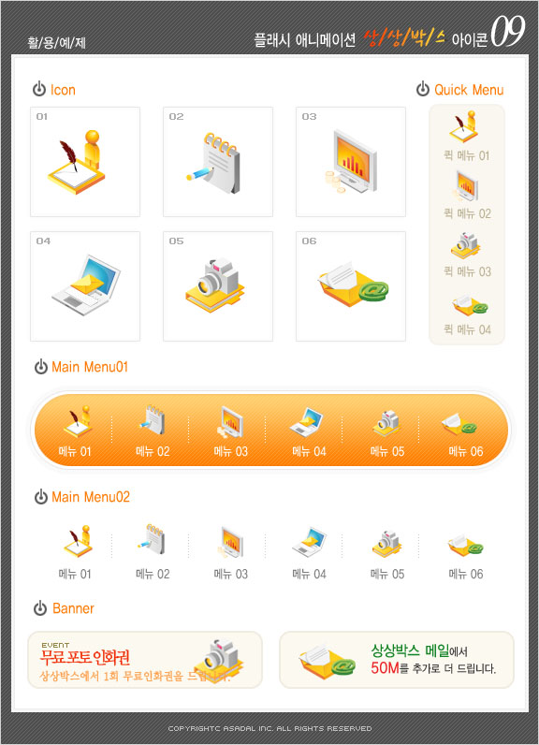
Communication Model
LTI will follow the following communication channel to interact
Communication in Agile Methodology
Audio / Video Conferencing
Status Reviews
Peer Reviews
Issue Resolution
Audio / Video Conferencing
Phoenix
LTI
Phoenix
Daily Call between QA, Dev and QA Coordinator (Query Resolution)
Daily Stand Up (Includes Defect Triaging) and updating Dashboard in JIRA
Communication & coordination required on change requests, issues and observations
Email
LTI
Weekly status reporting Guidelines, Schedule
Frequency | Objectives | Reporting Format | LTI | Phoenix
Weekly | Status of work performed, upcoming tasks, highlight current issues, risks | Weekly Status Report | Test Lead | Test Manager
Monthly | Monitor Deliverables & Measurements, Prioritization & Planning, Forecast- Resource Loading | Monthly Status Report | Teat Manager | Test Manager
Milestone | Review key milestones as they are met, any open risks and their mitigation plans, quality of deliverables, escalations/ appreciations, value adds, suggestions | Milestone Status Report | Delivery Manager | Delivery Manager
Project End Review | Project End review to gauge the overall success of the project. Review deliveries, targets, resource utilization and issues at the engagement level | Project Closure Report | Account Manager | QA Head/ Account Manager

Slide 12
RACI Chart
Task | LTI | Phoenix
Test Strategy & Planning | R, A | C, I
Functionalities & Requirement Definition | C, I | R, A
Test Case / Automated Test Script Creation | R, A | C, I
Test Execution & Reporting | R, A | C, I
Test & Defect Management | R, A | C, I
Demand Forecasting | R, A | R, C
Demand Management | C,I | A, R
Process & Tools Standardization | R,A | C, I
Project Management | R, A, C | I
Knowledge Management | R, A | I
Governance & Reporting | R, A | C, I
Risk Management | R, A | C, I
Test Environment Management
R | Responsible
A | Accountable
C | Consult
I | Inform

Slide 13




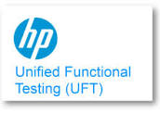

Test Automation Approach
Application
Analysis
Framework Building
Script Creation
Script
Execution
Maintenance
Activities
Tamro Requirement Analysis
Automation Feasibility Study for UI and Mobile apps
Perform PoC with representative 4-5 test cases to validate the tool feasibility
Configuring Automation Framework
Planning the approach based on interaction of automation tool with the application
Test Data preparation for automation in consultation with Manual test team / BAs
Test script design
Dry run of prepared test scripts on stable application
Walkthroughs of test scripts and demos
Execution of the test suites from the test management tool or on local machines
Analyzing the results of execution
Root cause Analysis
Maintaining the automation suite with changes in the application
Deliverables
Test Automation Plan
Test Automation Feasibility document
ROI Analysis
Ready to use Framework
Test Data
Automation Design
Object repository
Automated test scripts
Automation Test Suites in the test management tool
Test Execution Status report
Test case Execution Results
Defect Reports
Updated Automation scripts
LTI Solution Accelerators
Based on the current understanding of Tamro’s application landscape Test Complete tool can be leveraged for Test Automation.
Data Testing Framework
Test Automation Framework
Browser compatibility Testing
Commercial Tools
HP UFT
HP ALM

Slide 14
Best Practices for Future Proof Automation
Periodic execution of test scripts.
Regular Script maintenance as per functional changes
Business process level components, internally utilizing object-level keywords for ease of maintenance of scripts
Modular test automation framework with seamless integrations with the tools and technologies being used in Tamro
Data driven approach and parametrization to validate large volume of data combinations
Object Repository for ease of maintenance of object locators

Slide 15
Proposed Development Cycle
WIP
QA Test Result Validation
Pre-Prod Test Result Validation
QA Deployment
Pre- Prod Deployment
In case of GxP relevant Process
Requirement Analysis, Test Plan & Strategy
Test Design (Manual and Automated)
Environment Dry Run
Performance Test
Security Test
We will leverage Phoenix Test Management Tools (TestComplete) for streamlining above mentioned activities

Slide 16
Risk Based Testing approach for Compliant GxP relevant processes
Validation Activities for GxP Relevant Processe
Identify Pre-defined test cases around GxP relevant processes
Develop Test plans, test procedures, test cases & Test Data if not available
Develop Automated Test scripts
Perform the test execution and Evaluate results and compare with acceptance criteria
Document results
Ensure optimum Performance by system performance tests
Document Deviations from the project plan and perform risk assessment for deviations
Maintain test artefacts and logs in Honda specified repository
Identify if changed process is a part of GxP relevant processes e.g. Picking, Packaging, Sales Order Processing etc.
Factors to Identify Risks
Consequence of failure
External system interfaces
Frequency of use
Technical complexity
Maximum code changes
Maturity of technology
Complexity of defect removal after deployment
Domain expertise
Perform critical requirement analysis (user stories) with the help of business SMEs & development team and identify business priority
Identification critical
business requirements
Impact analysis
Identify other impacted processes through RTM
Follow Validation Activities
Benefits of RBT approach
Test high priority
& high impact
requirements
Defect detected early
in software lifecycle
Optimal Testing &
high risk area Testing
LTI will synchronize with Phoenix business SME’s and Quality Managers to understand GxP compliance needs and align to SOP’s accordingly.
Notes:
Can you work GxP compliant (Templates according to our SOPs etc)?

Slide 17
Indicative KPIs
Governance Layer | Impact | SLA/KPI | Description | Frequency | Applicability
Strategic | Application Stability | Testing Effectiveness | % of [Total number of Critical Defects found Post Delivery/ (Total Critical Defects Reported + Post Delivery Critical Defects)] | Monthly or Release based | Will be Applicable as the engagement model matures
 | Skill improvement | Training and certification | % of [Total number of Critical Defects found Post Delivery/ (Total Critical Defects Reported + Post Delivery Critical Defects)] | Semi-annually
 | Cost Reduction | Year on Year Cost Reductions | % of [Total tasks planned – Total tasks completed on schedule]/Total tasks planned for the reporting duration. | Yearly
Tactical | Quality | Defect Rejection Ratio (DRR) | (Number of Rejected Defects which are in Tester’s Control /Total number of Defects Logged) X 100 | Monthly or Release based
 | Cost Reduction | Tools Utilization | % of [Total Actual Effort – Total Planned Effort]/Total Planned Effort. | Yearly
Operational | Productivity | Team Velocity | Indicates the performance of the team during the past sprint in terms of story points completed | Sprint End
 | Cost | Burndown Chart | Compares the sprints progress as planned versus actual in terms of estimated task hours | Sprint End
 | Cost | Testing productivity | Number of test case executed/Test Execution Efforts | Quarterly | Applicable as of today
 | Cost | Effort deviation | [Actual Effort – Estimated Efforts]/Estimated efforts | Quarterly
 | Cost | Automation Coverage | Indicates the amount of automation done against the total number of manual test cases developed | Sprint or Release End
 | Quality | Defects by Severity per sprint/story | Indicates defects severity trend at a sprint/story level | Sprint End
 | Quality | Test Case Coverage | [Test cases executed/Total agreed Test cases to be executed in Test Suite]X100 | Monthly
 | Time | Total Testing time | Total testing down time/Total Test execution time | Monthly
 | Cost Control | Effort Variance | % of [Total Actual Effort – Total Planned Effort]/Total Planned Effort | Monthly or Release based

Slide 18
What would the organization look like?

Slide 19
Questions Mapping
Questions | Slide# | Remark
Person onsite as bridge to offshore colleagues? Will he take over the “testmanager role” for offshore testing team? What are the tasks/responsibilities of “our testmanager” and “your testmanager” in the intended setup? What would be your recommendation | 19
Who is responsible for knowledge transfer if we want to ramp up or if some of your testers will leave you and you have to replace internally? Who will be charged for that effort? How big is your fluctuation? | 20 | LTI Will be Responsible
How to transfer knowledge back to us/another company? Where will be the testscripts/documents etc stored? Who owns them? | 22

Slide 20
Proposed Team Structure
Phoenix Team
LTI Team
Onsite
Offshore
Test Manager
Test Lead
Automation Test Lead
Automation Test Engineer
Automation Test Engineer
Automation Test Engineer
Process SMEs
On Demand Flexi Team
Flexi Team (Automation Engineers, Analyst etc.)
Onsite Test Lead | Automation Test Lead | Automation Test Engineer | Flexi Team
Sync up with Phoenix Test Manager and Process SMEs to understand testing requirements Coordinate with Offshore LTI Testing Team | Accountable for testing schedule, offshore deliverables quality and timeline Offshore Test Lead will Enhance or create automation framework to suite project needs Manage day-to-day project deliverables along with test team members | Design and Development of test automation framework Preparation of automation function libraries and keywords Preparation of test data Preparation of automation test reports Execution of testing scripts/scenarios for the ongoing releases Defect Management | Onboarding- Identified resources will be on-boarded to projects Ramp up- Increasing the number of resources in the flexi team as per the test projects requirements Ramp down-Ramp down of resources from the flexi team will be initiated once the requirements are fulfilled Residual Project Team-The core team provide a continuous support, delivering execution of tests and knowledge retention
Phoenix Test Manager
KT Monitoring Providing necessary support and environment for Testing processes Regular coordination with LTI Test Lead

Slide 21




Resource Ramp-up/Ramp down
Replacement of existing resources
Leverage checklist of all the onboarding and off boarding formalities for various applications
Selection of candidate based on the skill set
Creation of Cross Skill Matrix
Use of available knowledge transition plan and KCDs will be update every month/bi weekly to keep it up-to-date
LTI will be responsible and charged for knowledge transfer if you want to ramp up or in case of replacement of testers.
We will capture knowledge gained on Phoenix Application, Process, Tools & Technology and Prepare KCD’s on regular basis Or update existing KCD’s with proper version control during execution / Release
Adding New Resource in the Project
Utilization of cross skilled resources or selection of associates who has similar experience and exposure to necessary skill
Assigning a dedicated mentor to the newly added associate
Having readily available access ID (a pool of Access ID) inturn reducing the time for system access
Up-to-date KCD for ready reference
Notes:
Who is responsible for knowledgetransfer if we want to ramp up or if some of your testers will leave you and you have to replace internally? Who will be charged for that effort? How big is your fluctuation

Slide 22
Proven approach for Knowledge Transition
Planning
Knowledge Acquisition, Verification and updation of knowledge base
Sign-Off
TRANSITION KICKOFF
GATHER KNOWLEDGE
CLARIFICATIONS
SHADOW
REVERSE SHADOW
Sign-off
Refine Transition Plan
Tool based capture
Q&A
Support in TC updating and creation
Guided TC execution and defect mgmt
Review of KCDs by SMEs and Sign Offs
Resource mapping with Incumbent
Study KT documents of incumbent vendor
Co-relate work items
Identify gaps in KT artefacts
Mock steady state
Finalization on artefacts
Study defect history
KT Documentation
Monitor transition progress and risks
Cutover activities
Agree on testing process
Automation Feasibility
Certification
Support UAT coverage
Phase closure
Assess risks
Deliverables
Baselined transition plan
Team ramp-up
Templates for agreed deliverables
KT Curriculum
Testing Book of work
Knowledge Map
Understanding of functional aspects of application
Understanding test strategy, test cases, databases and test processes
Complete knowledge on defect dump provided
Finalize Transition Plan
App Certification
Repository building and maintenance on LTI SharePoint with shared access to Phoenix
Execution Report, Defect Report, UAT Support
Dashboard for execution status and defect tracking
Signed off KT documents
Signed off SLAs
Updated risk assessment
Mutually agree upon analysis of test cases received from incumbent

Slide 23
Exit Strategy
LTI 3 Step Process for Knowledge transition
Step 1
Grouping of functional/technical areas to have a focused transition
Step 2
Aligning the knowledge transition timeline based on application complexity. Transition complex areas first
Step 3
Leverage the Knowledge captured and documented during the engagement
If LTI has to exit the engagement, then LTI assures Phoenix the transition of the knowledge gathered during the course of this engagement to the new team(Phoenix and/or 3rd party partner) within optimal time and cost to ensure minimal disruption to Phoenix’s business. LTI will also create a transition plan to track the transition process and progress.
Test scripts and documents will be stored in Phoenix’s repository.
Ownership of all the test scripts and documentation lies with Phoenix.

Slide 24
Tooling/Environment

Slide 25
Questions Mapping
Questions | Slide# | Remark
Are the necessary test environments in place? Are they separated from dev environment? Who will setup the applications in the test environment? Who is preparing the test data and the test context in the test environment? Will this be part of the automation scripts? | 25, 26 | As per best practices Test Environment should be separated from dev environment. LTI has strong TEM capabilities as showcased in slide ##
Is it possible that you use TestComplete/SmartBear? If yes, would this mean a change in charging? | 27

Slide 26
Test Environment Management
6
Key Highlights
Phoenix
LTI
Our Key activities for Test Environment Management includes Environment Planning and provisioning, Environment Delivery, Data Management and Maintenance
Test Environment Management will comprise of Test Environment Analysis, Transforming Blueprint, Updating Test Environment strategy
It will also include Updating Data Governance strategy, Setting up Compliance Validation framework,
Setting up Change management, Demand and Capacity planning, Establishing Application Onboarding office, Operations Handover and Calibration are also part of Test Environment Management
Release
Management Team
Send Release Notes
and Environment status to Environment team
Build Environment as per Request
Code/Release Installation
Test Envn. Management Team
Communicate with Release Management Team
Get confirmation from release management team about working Environment and handover to project team for testing
Request for New/Current Environment
Project/ Testing Team
Yes
Env Issue?
No
Sanity Test Passed?
Yes
Perform Release/ Regression Testing
Test Environment Setup Request
LTI will do the initial setup of Test environment but the hardware setup will be the responsibility of Phoenix IT team
LTI team will validate environment setup, application deployments on test environments done by Phoenix IT / dev team, through Automated Smoke / Sanity test

Slide 27
















Test Data Management
Typical Test Data Management using LTI’s ETDM tool
Load ‘ Enough & adequate
data for all systems
Data Privacy & Regulatory Compliance,
Ref- Integrity of Masked Data,
Profiling
Data Provisioning
SVN Test Data
Repository
Test Data
Request
Production
Subset
Masking
Sensitive Data Discovery
Golden
Data
Test Environment
Data Refresh
Synthetic Data Generation
On Demand Data Generation for new
Features/Systems Production –like volumes
for non – functional Testing
Data Governance
End- to -End Automated ETDM Solution
Knowledge Base
Test Data and Environment Management Activities
LTI will consult with functional / business SME and development team for existing Set of Golden Test data
Leverage LTI proprietary tools (ETDM) for future Test data generation needs. Automated Test data generation scripts will be prepared in consultation with Process SMEs / Dev team based on the requirement.
Manage Golden Set repository for all identified test data across the related applications
Test environment setup and deployments will be handled by Phoenix IT team.
Notes:
Who is preparing the test data and the test context in the test environment? Will this be part of the automation scripts?

Slide 28
Tool Comparison
Category | HP UFT | Test Complete
Ease of Script Creation | High | High
Licensing Cost | Moderate, reduced cost | Moderate (Much cheaper than UFT)
Effort of Maintenance | Medium | Medium
Support for Browsers | Google Chrome Internet Explorer, Firefox | Internet Explorer,Google Chrome,Safari,Mozilla Firefox,Opera
Support for Non Browser Based application, | Yes | Yes
Support for Embedded/ Flash Objects, | Yes | Yes
Language Support | VB Script | Java Script, VB Script
Coding Skills Required | Medium | Medium
Mobile Platforms supported | Can be utilized after collaboration with other HP products Supports Android, IOS and Windows | Android 4.0 onward iOS 5 onwards No Windows support
Parameterization | Data can be typed in or imported from databases, spreadsheets, or text files. | Data can be typed in or imported from databases, spreadsheets. Supports Test Data generation too
Support to custom objects | Moderate | Moderate
Web Services Testing | Yes, Inbuilt | Yes uses SoapUI
TestComplete/Smartbear
Based on the comparison TestComplete offers similar features.
However in similar kind of engagement earlier, we had observed challenges of automation of list items in Oracle Forms using TestComplete.
We recommend 2 weeks PoC for TestComplete.
During PoC we will automate 2-3 representative end-to-end scenarios and establish the feasibility of the tool for automation.
Notes:
Is it possible that you use TestComplete/SmartBear? If yes, would this mean a change in charging?

Slide 29
Assumptions
Technical feasibility of the scenarios will be conducted prior to start of the Automation. Scenarios found not suitable for Automation will not be considered and will be communicated to Phoenix team.
Test Data would be generated for generic process level scenarios. However for the scenarios with domain specific complex logic will be provided by Phoenix process SMEs.
Use of Tools and LTI Accelerators is subjected to the feasibility of implementation

Slide 30
Phase 2- Transformation and Continuous Improvement

Slide 31
Proposed Future Quality Assurance Operating Model
Phoenix
Change Management
IT Support
Test Planning
QA advisory services
Application Maintenance
Functional
Non Functional Testing
Core – Flex Model
Requirements Management
Stakeholder Management
Project Management
Project Retrospection
Integration Testing
Delivery Management
& Business
Demand Management
Estimation, Assumptions, Test Strategy, Scope Management, Dependencies
Defect Management
CoE Model
Integrated
with
Test Data Management
Business Process Testing
Mainframe Testing
Automation
Capacity Planning
Demand Management
Risk Management
Process Standardization
Vendor Management
SAP / Oracle Testing
UAT Support
Global Delivery Platform
Knowledge Management
Distributed Delivery
Application Development
IT PMO
Test reporting
Metrics & SLA Reporting
Goals | KPIs | Metrics
Technology CoE
Demand Forecast
Standardization
Test Maturity Assessment
Governance

Slide 32
Transition from Current Model to Proposed Model
Current Model
Proposed Model
Resource request based demand
PMO Invoicing (T&M)
No formal SLAs
Cost variance
Project request based demand
Invoice for services consumed (capacity/output based)
Risk & Reward based SLAs
Predictable cost
Partnership
Business
Ad hoc metrics reporting
Project dependent processes & methodologies
Joint Ownership
Interactive automated dashboards
LTI ensures cross skilling & knowledge management
RBT implementation across portfolios
End-to-End Ownership with LTI
Operations
Tool provisioning by Phoenix
Automation toolset not scalable & flexible
Limited implementation of existing tools
Regression driven Automation
Leverage technology & innovation group
Leverage LTI PLATO and Solution accelerators to be part of service
End-to-End Automation
Business
IT

Slide 33
LTI 2.0 Strategic Roadmap
Test Data Management
Assurance for meeting GDPR Compliance requirement
Continuous Improvement Through Predictive Analytics
Moving From Waterfall to Agile
E2E Automation and Orchestration

Slide 34
Success Stories

Slide 35
Leading Pharmaceutical and Healthcare Data Analytics Intelligence Company
Client | Industry | Country/Location
Leading Pharmaceutical and Healthcare Data Analytics Intelligence Company | Healthcare | US
Client Objectives
What was Delivered
Business Outcome
Ad hoc Technical governance of “component integration”
Off the cuff configuration management & release management
Lack of “pragmatic” a process framework
Dedicated Offshore Testing Center with focus on Testing of various DW/BI- ETL CUBE Testing, Web & Mainframe Apps
One stop for End to End Testing Services spread over Functional, Performance, Security and Test Automation
Established mature and efficient Testing Processes enabling 100% Offshore Based Service Delivery
On demand short duration Onsite presence leading to maximum cost savings for the client
Successfully supported Application Rollout Testing across EMEA, APAC and Rest of the World
Improved scalability , Flexibility & Breadth of Testing functions
Competitive advantage due to high quality releases and reduced time to market
Reduction in the overall TCO (Total Cost of Ownership) of Testing
Improved Testing effectiveness by implementing industry best practices

Slide 36
Leading US based medical device, pharmaceutical and consumer packaged goods manufacturer
Client | Industry | Country/Location
Leading US based medical device, pharmaceutical and consumer packaged goods manufacturer | Pharmaceutical | US
Client Objectives
What was Delivered
Business Outcome
Maintaining Compliance Processes
Enhancing Test Coverage
Process Knowledge :Understand business process with available test cases pre-approved by business in excel format.
Master Data for Execution: Tester needs to coordinate with functional team to generate master data during execution of SIT itself
Compliance Process: Client Compliance process to be followed for testing artifacts and result recording
LTI conducted Validation to achieve compliance using Qualification methodology using:
Installation Qualification (IQ)
Operational Qualification (OQ)
Performance Qualification (PQ)
This provides documented proof to ensure that the that a specific process will consistently produce a product meeting its pre-determined specifications and quality attributes
Maintenance of a robust governance process
Cross Skilling of resources
High quality of test results due to stringent compliance norms
Improved application quality due to enhanced test coverage
No failure compliance lead to re-execution of test run, help in completing test execution in time.
Considerable Time savings as RPO were able to approve test results faster due to ready available screen shot
Faster resource onboarding due to ready to use Test result with screen shot
Real time updating of Test progress & defects during Test phase enabled Faster time to Market

Slide 37
Test Automation for A Leading US based Global Bank
Client | Industry | Domain Area | Country/Location | Team Size
A Leading US based Global Bank | Banking & Financial Services | Capital Markets | US | 26
Client Objectives
What was Delivered
Business Outcome
Reduce time to market
Increase automation coverage
Run regression in the lights-off mode
Test Automation Consulting(Automation Feasibility Study, Automation Current State Assessment, Framework Development & Enhancement)
Specialized Testing Services(Agile Shift Left, Continuous Integration and Test Data Generation automation)
Lean Regression Automation Testing
CI Test Automation using LTI in house tools:
FAST framework- Automated execution using Jenkins and consolidated execution reports integrated with HP-QC
DTF - Validated executed ETL jobs
Test Data Management (TDM) - Generated realistic data on latest production trade transaction feed files
Achieved a Y-o-Y productivity improvement through automation using Selenium
Focus on E2E Test Automation spanning across Integrated Technologies & Application Portfolios
Early automation in practice, reduced time to market by 30%
Implementation of Continuous integration automation for sanity testing and regression testing reduced the testing cycle by 50%
Near-zero defect delivery
Reduction of defect rejection rate to less than 5%
Improved automation coverage upto 40% across apps
Faster delivery through quicker test cycle
Ramp up of team within 2 weeks of lead time

Slide 38

Leading P&C Insurer in US
Client Profile
Client is a leading insurance company in the US that offers a wide variety of insurance and surety products, as well as risk management services, to numerous types of businesses, organizations and individuals.
Business Need
What was Delivered
Business Outcome
Provide End to End Testing Services enterprise wide
One of the major challenges was to support the entire gamut of claims applications with complex flows and multiple integration points
Achieve technology currency with minimal business interruptions
Reduce dependency on business and functional folks
Automated solution for en-to-end data validation needs
As a preferred partner established an offshore ‘Testing Centre of Excellence’
Implemented in-house solution ‘RADAR’ – Data Testing Framework for validating the data across homogenous and heterogeneous systems with 100% test coverage
Established a “Factory Model” to achieve Quick Conversion, and higher testing efficiency to execute Visual Basic 6 Elimination
Conducted Web Services Testing - Request & response using Soap UI
Supported mobile testing through comprehensive mobile testing services (simulators, using perfecto mobile lab) which includes tablets and smart-phones
Delivered application conversion within cost, schedule and minimal production fallout
Formulated & successfully implemented remediation strategy & plan for Windows 2008, SQL Server 2012, .NET 4.0 upgrade
Transition from waterfall to Agile testing practices
Gained Subject Matter Expertise collaborating with all functional groups and Business team
Matured Testing process (Path to best in class transformation MIQA model)
40% reduction in efforts through automation which led to over 60% reduction in testing cycle time
Implementation of RADAR ( Niche solution ,Increase the automation and test coverage % thereby reducing 88% efforts and manual intervention
Engagement reporting (Collaborative and transparent relationship)
90% Metrics report generation effort saving with Metrics reporting tool
Implemented industry best practices shift left, automation, continuous integration Innovation & thought partnership assisting business solutions
The APPLE/CAP tool is now in production and has been made available to the Field Management team. Thank you all for your hard work and congratulations on a job well done! It has been a pleasure working with you all on this project and I am honored to have been given the opportunity to join such an admirable team. Thank you all and great work!
- Client Business Lead

Slide 39
“Enabled Customer to adopt Agile Testing as part IT Strategy”
Client | Industry | Service Areas Alignment | Country/Location | Size
Leading US Based P&C Insurer in US | Insurance | Agile Methodology | US | 25
Client Objectives
Approach
Value Delivered
Move from Waterfall based release cycle to Agile based to address the business dynamic
Effective & efficient delivery of SAFe (Scaled Agile Framework) with a optimized onshore - offshore model
Leverage best practices, process and tools for Agile testing
Focus on automation to improve in-sprint coverage
4 hour dedicated collaboration overlap time with Onshore team on a daily basis
Implemented Agile Testing specific lean and traceable processes for program
Implemented customized Continuous Integration utility which kicks off Service level and Function Automation Smoke test suite simultaneously
200+ Hours of innovation evolving 11 unique ideas leading to effort savings at various stages of testing
Defined Test Data Management process to overcome Production like data limitation for testing and establish referential integrity
Techno Functional Skill set by Cross training QA Team on Automation Testing and Performance Testing
Reduction in test cycle time by 40%
Shift Quality Left - 81% High and Critical Defects found in first integrated environment

Slide 41
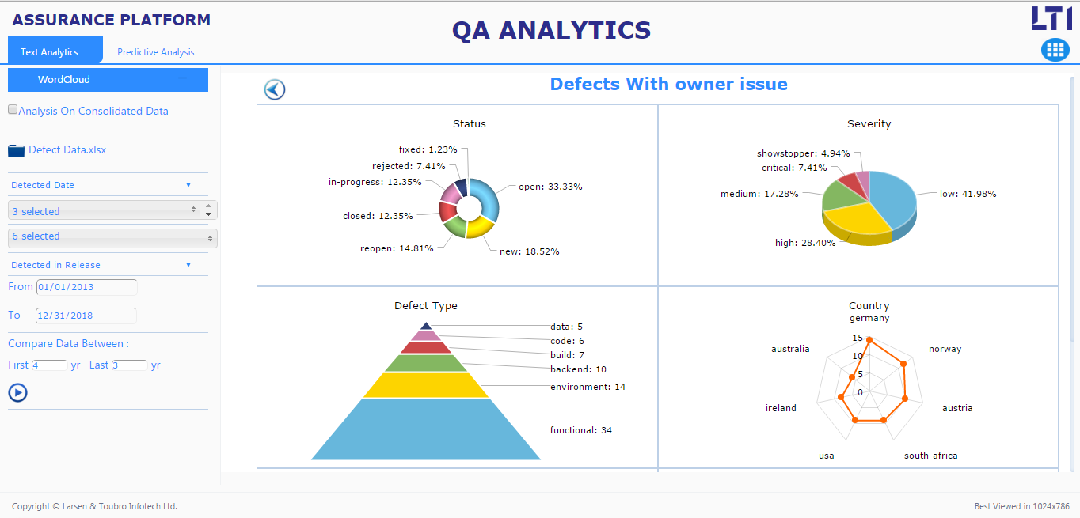
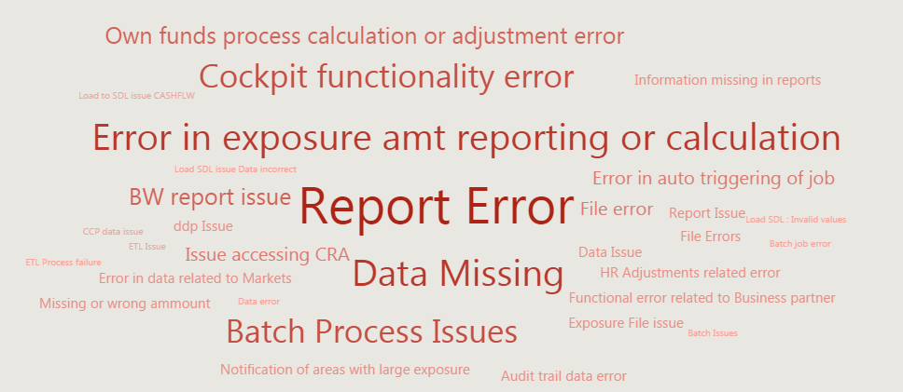
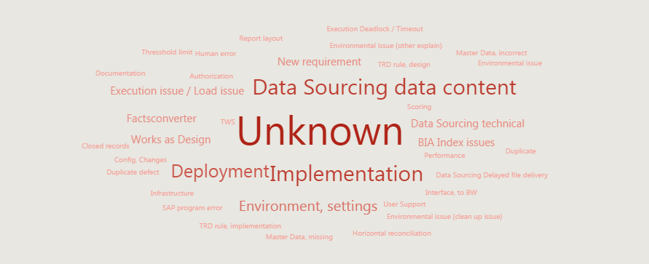
Use Case: Predictive analysis by QA analytics & proposed recommendations for Leading financial services group in the Nordic Region
Continuous Improvement Through Predictive Analytics
2
Key Highlights
LTI QA Analytics uses AI to analyze historic data like Defect Data, Release Data, critical Business Areas, etc.
LTI will leverage this tool to collate data from different sources like JIRA, HP ALM, other logs
Through the Predictive model arrive at defects area to be focused for subsequent release
Based on the prediction realign QA strategy.
Observations
Interventions proposed
Inferences
Top Defect Areas / Categories
Analysis by QA Analytics
60% defects - “Data Sourcing Data Content” (Implementation, Deployment & Environment Setting)
30% defects - No Root Causes Assigned
13% defects - Deployment Issues
Low level of functional E2E business scenario test automation
Lack of Discipline - As evidenced by high number of blank RCAs & application area field
Testing Ineffectiveness – Reflected in sudden increase in October production incidents
Testing Discipline through HP ALM –
Making Root Cause, Application Area, Closing Date etc. fields mandatory
Updation of defect closure by Dev & Test Teams
Continuous Improvement –
RCA of all production & UAT defects for release retrospection
Ensure implementation of Test Strategy
Deploy a “Rapid Automation Team”- > 80% automation of functional regression in 6 months
Defect Root Cause Analysis
Notes:
How to ensure that the automated tests will run also in the future? How to inform you about changes that you can adapt the scripts?

Slide 42

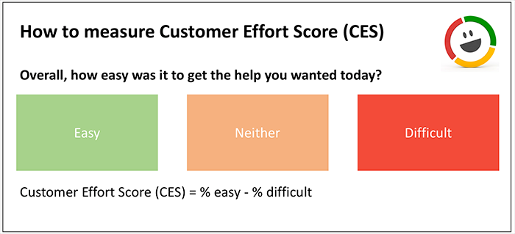





Customer Experience Assurance
5
How Customer Experience is measured today
Key Highlights
Discoverability
Google, Bing, App Store
LTI’s ‘Digital Customer Experience’, DiCETM, enables organizations to analyze & strengthen this experience across the customer journey. Tools used include:
LTI MUTE – for measuring customer perception and sentiments
LTI Performance Assurance: CoE with capabilities and solutions to cater to the performance dimension of customer experience.
LTI WebCASA –Test of Discoverability, Accessibility and Omni-Channel Experience
Analysis is recorded in a detailed report and a DICE Scorecard is generated giving instant comparison against peers and against standard benchmarks.
Net Promoter Score
Customer Effort Score
LTI Solution to addresses 5 Dimensions of Digital Customer Experience
Accessibility
Compliance Standards
Performance
Page Load Time
Output
Omni-channel
Experience
Consistency across Devices, Wearables
A Score
No actionable improvement areas
Reactive
Perception
Visual Appeal,
Patience, Attention
LTI bring Brainwave mapping to measure of Digital Customer Experience
Measures end-user’s mind waves, while he goes through the application/ website and determines customer’s perception
Converts customer’s feelings and reactions into scaled reading and checks for parameters like patience, visual appeal and thinking
Mindwaves in Usability Testing and Evaluation

Slide 43
Test Environment Management
6
Key Highlights
Phoenix
LTI
Our Key activities for Test Environment Management includes Environment Planning and provisioning, Environment Delivery, Data Management and Maintenance
Test Environment Management will comprise of Test Environment Analysis, Transforming Blueprint, Updating Test Environment strategy
It will also include Updating Data Governance strategy, Setting up Compliance Validation framework,
Setting up Change management, Demand and Capacity planning, Establishing Application Onboarding office, Operations Handover and Calibration are also part of Test Environment Management
Release
Management Team
Send Release Notes
and Environment status to Environment team
Build Environment as per Request
Code/Release Installation
Test Envn. Management Team
Communicate with Release Management Team
Get confirmation from release management team about working Environment and handover to project team for testing
Request for New/Current Environment
Project/ Testing Team
Yes
Env Issue?
No
Sanity Test Passed?
Yes
Perform Release/ Regression Testing
Test Environment Setup Request
LTI will do the initial setup Test environment but the hardware setup will be the responsibility of Phoenix
Test Data will be prepared by Manual Testing Team

Slide 44






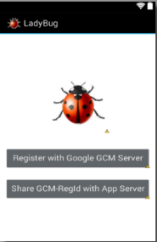












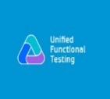






: E2E Automation & Test Orchestration
1
PLATO GUI
Configuration & Change
Management
E2E Business Assurance
Test Data Management
Test Environment
Management
Defect Analysis &
Prediction
Reporting &
Notifications
EXECUTION ENGINE
E2E Testing
Script/Data Repository
Defect Analysis
& prediction
Reporting & Notifications
Change
Impact Analysis
UI Automation
With
Business Process
Defect Analytics
Notifications
PDF Validation
Test Data Selector
Business Scenarios
Test Data Repository
Data Validation
Data Compliance
Test Scenarios
Application Specific
Library
Predictive
Analytics
Reports Engine
Test Scripts/Cases
Services Testing
Performance Testing
Integration with any Client Specific Tools
Benefits
Enables faster Continuous Integration and Continuous Deployment
Up to 80% of reusability of Test Scenarios & Scripts
Reduces test cycle time and testing efforts by ~50%
Reduces change management efforts
Significantly reduces script maintenance efforts

Slide 45
Test Data Management
2
Load ‘ Enough & adequate
data for all systems
Data Privacy & Regulatory Compliance,
Ref- Integrity of Masked Data,
Profiling
Data Provisioning
SVN Test Data
Repository
Test Data
Request
Production
Subset
Masking
Sensitive Data Discovery
Golden
Data
Test Environment
Data Refresh
Synthetic Data Generation
On Demand Data Generation for new
Features/Systems Production –like volumes
for non – functional Testing
Data Governance
End- to -End Automated ETDM Solution
Knowledge Base
Centralized Test Data Repository
Traceability from Requirements to Data
One-Stop Automated Solution
Create scenario specific; right sized test data
Avoid multiple versions of test data in the same environment
One Golden Set repository for all identified test data across the related applications
Map all required test scenarios to test data
Identify the stale test data based on in-scope/ out-scope requirements
Identify when, who, why a particular test data was created for
Modular approach for maximizing re-use of scripts & maintainability
Integrated solution to support E2E activities such as sub-setting, masking, synthetic data generation & user report creation
Automated solution to minimize the effort on creating test data
Customizable and scalable solution to accommodate user defined rules / conditions

Slide 46


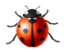

Assurance for meeting GDPR Compliance requirement
G
Key Highlights
Data Protection Officer
Test Consultant
Automated GDPR Tool empowering Data Protection Officer
Automated Data breach audit report with mobile notifications
Automated scanning sensitive information & identification of data points to be ported
Historical tracking of sensitive data, periodic changes in data & location
Early & continuous data protection
Release 1
DB
Source Data Systems
Automated
Audit Report
Release 2
DB
Automated
Delta Changes Report
Notifications of Sensitive Data Breach
Source Data Systems
Automated
Audit Report

Slide 47

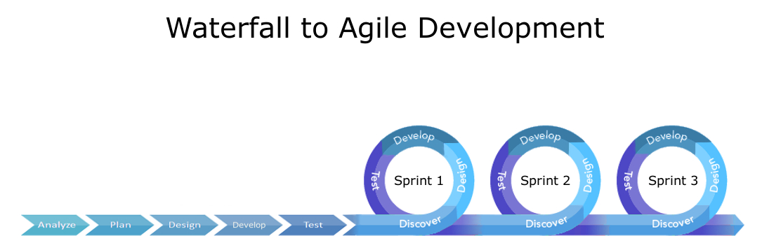
Moving From Waterfall to Agile
Projects following Waterfall methodology
Test Manager
Waterfall Testing Team
Test Analyst
Enabling transformation from Waterfall to Agile
On Demand:
Automation
Performance
Security
Trainings on:
Agile Adoption
Agile Frameworks
TDD, BDD
Sprint 1
Dev
Test
Test Manager
Daily standups between dev and Test Teams
Sprint 2
Test Analyst
On Demand:
Automation
Performance
Security
Sprint 3
Projects to follow Agile methodology

